Slide 1

DEPARTMENT OF COMPUTER SCIENCE AND ENGINEERING
2023-24
PROJECT ON
“AUTOMATIC EXAM PAPER GENERATOR”
PRESENTED BY
Mr. Shubham Rajkumar Vishwakarma
Mr. Kartik Balasaheb Pawar
Mr. Sanket Suryakant Lohar
Mr. Deep Tanaji Sawant
UNDER THE GUIDANCE OF:- Mrs. Dr. S. V. Balshetwar

Slide 2
Contents
1. Introduction
2. Problem Identification
3. Block Diagram
4. Scope of Project
5. Implementation
6. Proposed work
7. Expected outcome

Slide 3

Automatic Exam Paper Generator
Welcome to our presentation on the Automatic Exam Paper Generator, a revolutionary tool designed to streamline exam paper creation.

Slide 4
Introduction to Exam Paper Automation
Traditional Exam Paper Generation
The Need for Automation
Exam paper generation is often a tedious and time-consuming process, requiring teachers to manually create, proofread, and print papers.
Our solution aims to automate this process, freeing up valuable time for teachers to focus on other important tasks like student interaction and curriculum development.

Slide 5

Problem Identification
1
Time-Consuming
2
Error-Prone
Creating exam papers manually is time-consuming, taking away from other important teaching responsibilities.
Manual generation is susceptible to errors, leading to inaccurate or inconsistent exam papers.
3
Lack of Efficiency
The traditional process is inefficient, requiring significant effort and resources for paper generation.

Slide 6



Scope of Project
Enhanced AI-Based Question Generation
1
Incorporating advanced AI and natural language processing (NLP) techniques to
create diverse and contextually relevant questions.
Student Performance Analytics
2
Providing detailed insights into student performance to aid educators in identifying learning gaps and improving teaching strategies.
Integration with Learning Management Systems (LMS)
3
Seamless integration with platforms like Moodle, Blackboard, and Google Classroom for streamlined educational workflows.

Slide 7

Implementation
OpenAI:
Integrate OpenAI in flask
by installing the SDK, setting the API
Key, and using chatComplition.create()
to generate AI response from prompts.
LLM3:
LLM3 can be integrated into a flask app
By loading the model with Hugging
Face Transformers or using an API,
Then creating a route to send prompts and return generated response.
Automate Exam Paper Creation
The system automates the selection and arrangement of questions, saving time for teachers. By using predefined criteria like topic and difficulty, it ensures consistency and reduces manual effort in creating exam papers, making the process faster and more efficient.

Slide 8
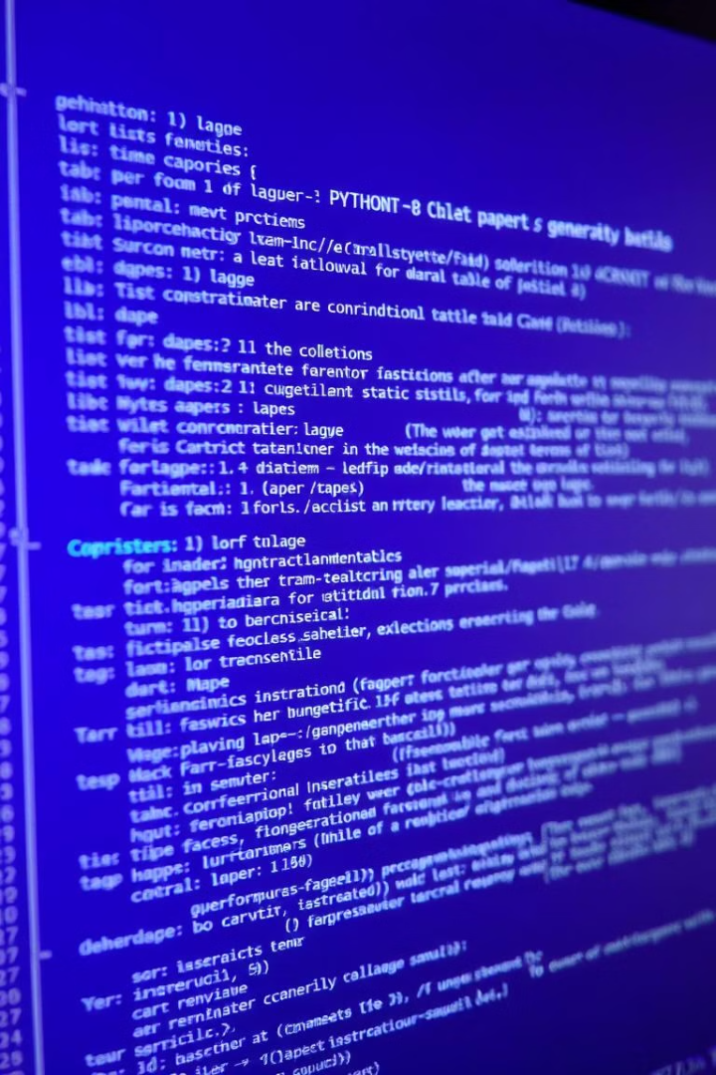
Proposed Work
1
Phase 1: Research and Design
Conduct thorough research on existing exam paper generation methods and design a conceptual framework for the automatic generator.
2
Phase 2: Development
Develop the software application based on the designed framework, including a question bank, paper structure templates, and the generation algorithm.
3
Phase 3: Testing and Validation
Thoroughly test the developed application, ensure its functionality and accuracy, and validate its effectiveness through simulations and real-world scenarios.
4
Phase 4: Deployment and Maintenance
Deploy the application for user adoption, provide ongoing support, and make necessary updates and enhancements.

Slide 9

Expected Outcomes
1.Automated Exam Generation:-
Seamless creation of exam papers based on selected parameters like topic, chapter, and difficulty.
2. Customization:-
Ability for educators to tailor exams according to their specific syllabus and preferences.
3. Time Efficiency:-
Significant reduction in time spent on manual exam preparation.
4. Error-Free Assessments:-
Ensures balanced coverage of topics and eliminates repetitive or incorrect questions.
5. Scalability:-
The system supports multiple subjects and institutions, making it scalable for largescale use.

Slide 10

Conclusion
The Automatic Exam Paper Generator holds the potential to revolutionize exam paper creation, making the process more efficient, accurate, and convenient for both educators and students.

